Slide 1

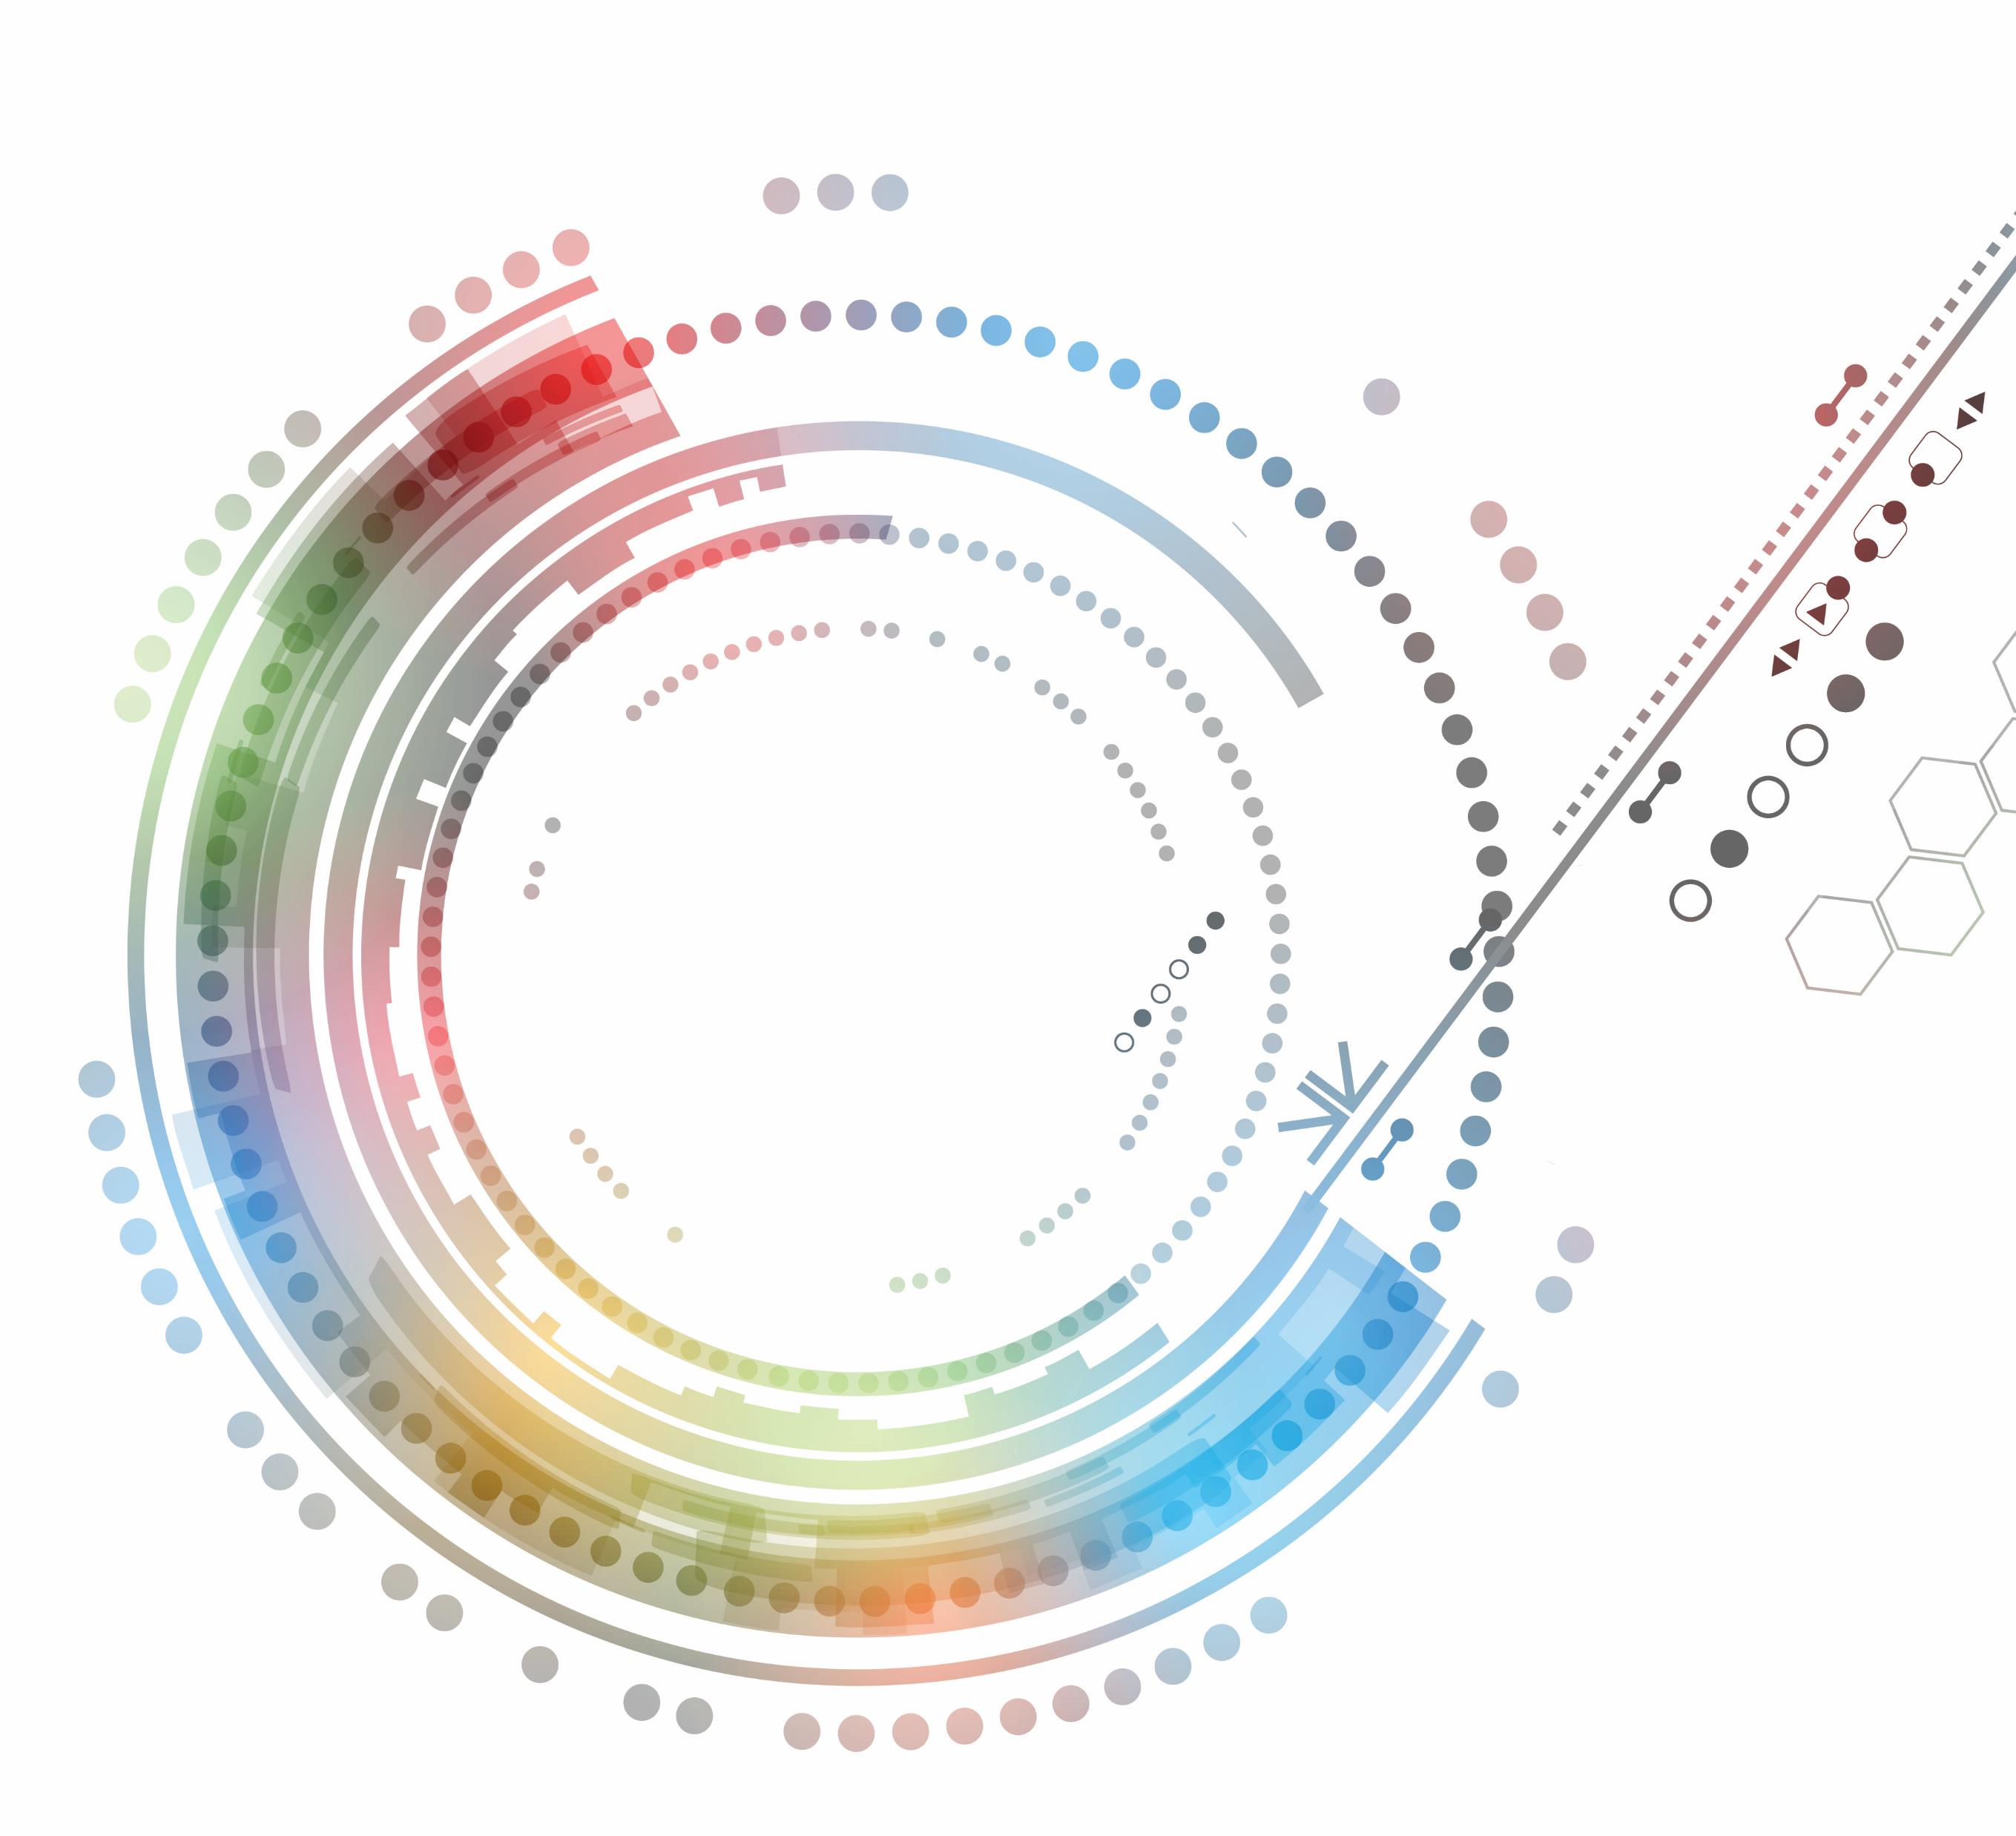
Foundations of Technology

Slide 2
Technological Inventions and Innovations
Unit 1: Technological Inventions and Innovations
Learning Cycle 3: The Role of Research and Development

Slide 3
Big Idea
Research and development is a problem-solving approach that allows business and industry to prepare products and systems for the marketplace.

Slide 4
Research and Development
Research and Development (R&D) is a process used by business and industry to yield usable information to improve the company’s operations or to develop products.
R&D is used for two purposes:
To develop new products
To discover new scientific and/or technical knowledge

Slide 5
Research and Development
Product design/development is driven by the “market” or the needs of the intended consumer and is heavily influenced by research and the profit motive.
R&D is essential to a company’s success, and the process of R&D is often carried out by engineers (developing new products) or industrial scientists (discovering new scientific/technical knowledge).

Slide 6
The Research and Development Process
Develop a Problem Statement - Identify the necessary information
Design a Process to Conduct Research - Develop questions and a process to collect information
Conduct a Research Study - Deploy the study, isolate variables
Analyze the Data - Determine useful data, highlight trends
Make Recommendations for Improvement - Provide results, conclusions, and recommendations

Slide 7
Research
Research is the search for knowledge and is applied scientifically and systematically to product design and development.
All research should be:
Systematic – a planned sequence that leads to logical next steps
Relevant – the data collected should be specific and should relate to the process
Controlled – all factors should be accounted for

Slide 8
Research
Types of research:
Exploratory – used for open-ended problem statements as a way to create familiarity with the subject; questions can be vague
Conclusive – used to test a specific idea or to collect specific feedback with a defined purpose; questions are clear and focused

Slide 9
Research Design
Research Design is the process of conducting a research study and analyzing the data for a specific purpose.
Design problems are seldom presented in a clearly defined form.

Slide 10
Research Design
Research Design is often broken into two categories:
Non-experimental – the degree to which two or more things tend to co-occur; does not demonstrate cause; all variables are not controlled
Experimental – the degree to which something always occurs; speaks to cause and effect; all variables are controlled

Slide 11
Data Analysis
Data Analysis is the process of collecting, cleaning, and manipulating data to determine useful information, suggest conclusions, and support decisions.
Analyzing data is often done by measuring:
Frequency – counts, numbers, percentages
Correlations – associations between groups, topics, ideas
Exact data – using the exact information collected

Slide 12
Data Analysis
When collecting data, remember:
Data is collected; it is not information until it is organized in some way and made meaningful.

